Slide 1

Intelligent Drawing Recognition by Application of Machine Learning
Riddhi Adhikari , Abhilash Mane, Shreyash Gadgil
Supervisor – Dr.Nilesh Raykar
Department of Mechanical Engineering
Sardar Patel College of Engineering
Mumbai, Maharashtra, India
Date: 2nd May, 2019

Slide 2
Table of contents
Scope and objectives
Motivation
Preliminary Investigation- Intelligent Recognition of Polygons in 2D drawings
Conversion of 2D drawings into 3D models
Identification of 3D primitives in 2D drawings
Orientation of 3D primitives in 2D drawings
Conclusions

Slide 3
Scope of Work
The work aims at conversion of 2D drawings of mechanical components into their 3D models without human intervention by applying Machine Learning models.
Objectives
Investigating the applications of Machine Learning in recognition of 2D drawings of machine components.
Applying Machine learning algorithms to identify 3 to 7 sided polygons with random shapes and segmented edges.
Comparing performance of Machine Learning Models with the one achieved from conventional code.
Applying Machine Learning models and Artificial Neural Networks to identify 3D primitives from 2D drawings.
Extending the earlier implemented concept to distinguish 3D primitives with and without features and to identify additive primitives from 2D drawings.
Determining orientation of 3D primitives from 2D drawings.

Slide 4
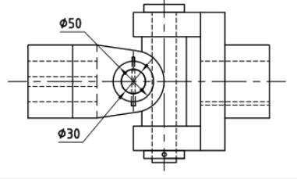
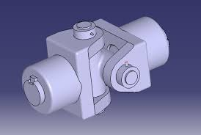
Motivation
Proliferating applications of Machine Learning in science and technology.
Implementation of modern manufacturing technologies require conversion of 2D CAD drawings into 3D CAD models.
Advent of automation and need of carrying out certain design operations independently without human involvement in Mechanical Engineering.
https://d2t1xqejof9utc.cloudfront.net/screenshots/pics/4accbfbfbffe3996f0a16a59720f3b40/large.PNG
http://machine-drawing.blogspot.com/2016/08/universal-coupling.html

Slide 5
SR.No | Author Name | Title | Discussion | Findings
1. | J. Lladós, E. Valveny, G. Sánchez, and E. Martí, | “Symbol Recognition: Current Advances and Perspectives” | Different approaches used for Dawing Recognition | Statistical and Structural approaches can be used for Drawing recognition.
2. | M. F. A. Jabal, M. S. M. Rahim, N. Z. S. Othman, and Z. Jupri | “A Comparative Study on Extraction and Recognition Method of CAD Data from CAD Drawings” | Various methods of data extraction and their limitations | The finding from this comparative study is the extractor cannot extract the drawing when the drawing have a noise or incomplete
3. | J. Flusser | “Moment Invariants in Image Analysis” | Selecting features that are invariant to rotation, scaling and translation | Features like coordinates, slopes and other geometric features can be used
4. | M. Vento | “A long trip in the charming world of graphs for Pattern Recognition” | Machine learning models that are developed for Pattern Recognition | Random Forest, Decision trees, KNN, SVC can be used for classification of shapes.

Slide 6
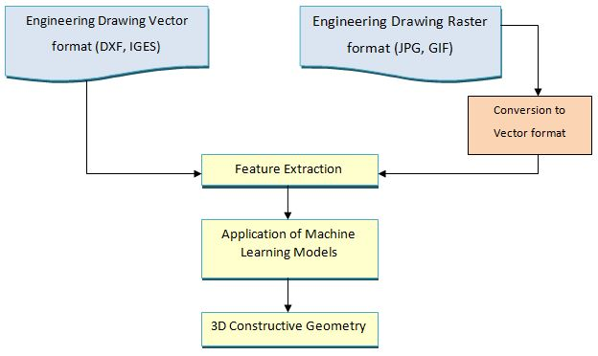
Typical Process of Drawing Recognition

Slide 7
Preliminary Investigation-Intelligent Recognition of Polygons in 2D drawing
Examined application of Machine learning in Pattern and Drawing Recognition.
Devised a typical process of drawing recognition.
Applied Machine Learning models like Random Forest Classifier, K Nearest Neighbors classifier (KNN) and Support Vector Classifier (SVC) for classifying 3 to 7 sided polygons with random shapes and segmented edges by using different sets of features.
Compared performance of Machine Learning Models with the conventional code.

Slide 8
Steps involved in conversion of 2D drawings into 3D models
Extracted Data from views
Identification of 3D primitives
Finding orientation of recognized primitives
Identifying location of a reference point on the primitives
Distinguishing dimensions
3D CAD model

Slide 9
Identification of 3D Primitives using Machine Learning
Machine Learning Models
Prism
Data
Brick
No. of edges in all 3 views of a 2D drawing
Random Forest Classifier, ANN
Pyramid
Tetrahedron

Slide 10
Dataset Generation
START
Input numbers of shapes, required and variation of shape required
The process of creating dataset is automated using an open source CAD software FreeCAD to obtain a CSV file with drawing data
3D shapes constructed with variation according to requirement.
3D shapes are projected on 2D planes and their data is saved on a CSV file
STOP

Slide 11
Dataset for training Machine Learning models
3D-1 consists of 10000 instances of 4 four basic primitives i.e. prism, brick, pyramid and tetrahedron
3D-2 consists of two different types of objects – Simple Bricks and Bricks with an added feature (A rectangular through hole)
3D-3 consists of all four basic primitives and their derivatives with a rectangular through hole and chamfer
3D-4 consists of derivatives of primitives formed by combining two different basic primitives along with the four basic primitives. Tetrahedron + prism, prism + brick, pyramid + brick, pyramid + tetrahedron are the four derivatives that form this dataset.

Slide 12
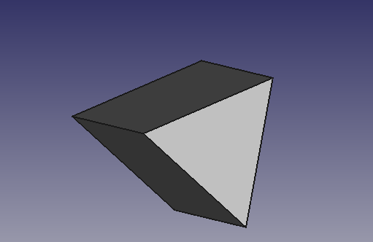
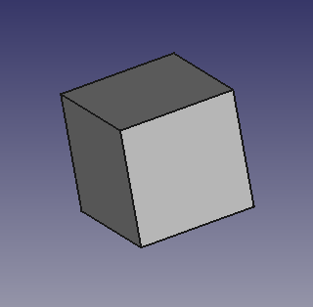
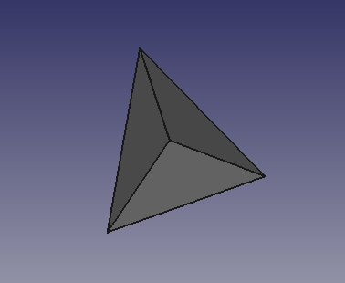
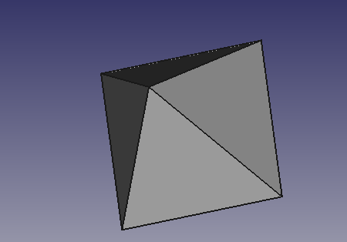
Geometric Data for current work
Tetrahedron
Pyramid
Brick
Prism
3D-1 dataset

Slide 13
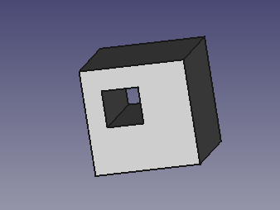
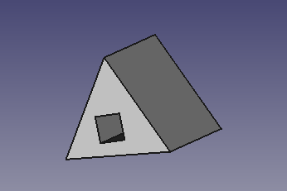
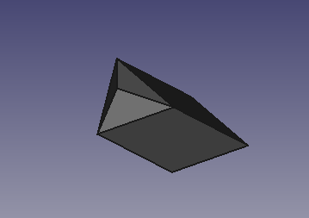
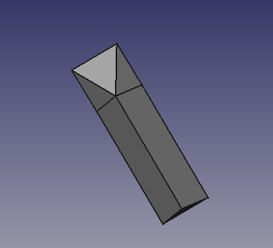
Slot Feature
3D-2 and 3D-3 Dataset
Brick with Feature (hole)
Prism with Feature (hole)
3D-4 Dataset
Prism + Tetrahedron
Prism + Pyramid

Slide 14
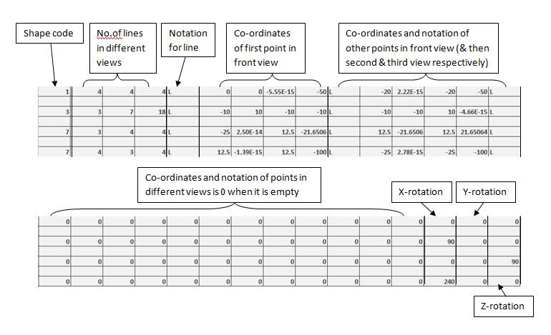
Structure of Dataset and Feature Selected
Shape code | Lines in front view | Lines in side view | Lines in top view | Co-ordinates of points in first view(100 columns) | Co-ordinates of points in second view(100 columns) | Co-ordinates of points in third view(100 columns) | x-rotation angle | y-rotation angle | z-rotation angle
Actual representation of the first few columns of the dataset
Actual representation of the last few columns of the dataset

Slide 15
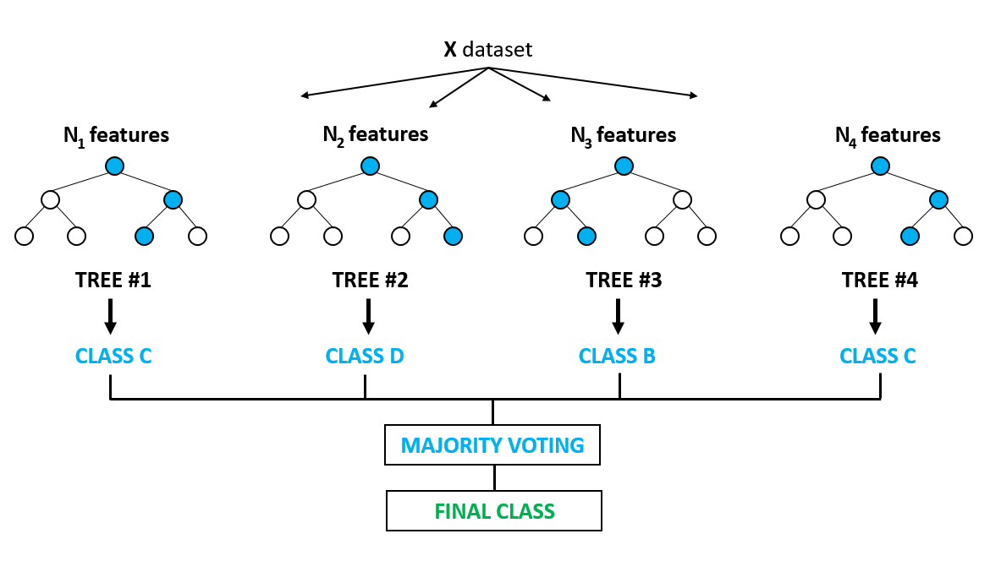
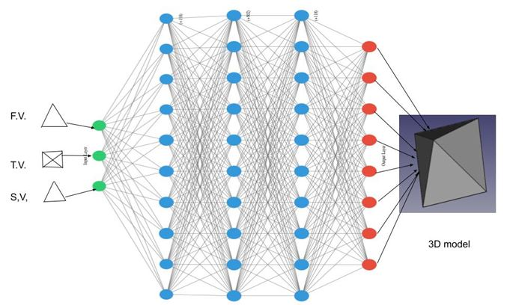
Machine Learning Models
Artificial Neural Networks
Random Forest Classifier
https://www.google.com/url?sa=i&source=images&cd=&cad=rja&uact=8&ved=2ahUKEwjmmezxvPnhAhXH73MBHS_aBGwQjRx6BAgBEAU&url=https%3A%2F%2Fwww.globalsoftwaresupport.com%2Frandom-forest-classifier-bagging-machine-learning%2F&psig=AOvVaw2t6FoAFFJR2RuS0IWeCLJ7&ust=1556770684245597

Slide 16
Application of Machine Learning Model
Start
Extracting input
Data Preprocessing
Dividing dataset into training and testing data
Define network input and target data

Slide 17
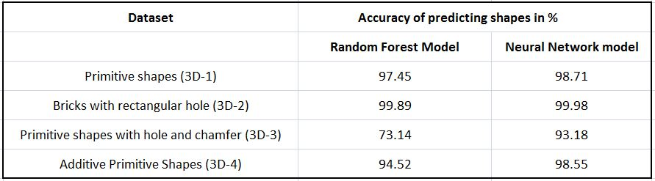
Comparison of results from different ML models

Slide 18
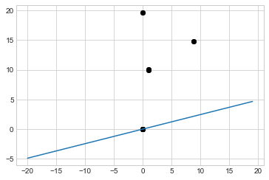
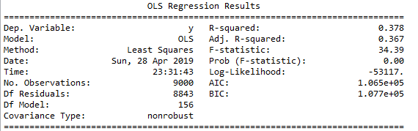

Identification of Orientation of 3D Primitives
Orientation was calculated using polynomial regression model. The input given to the model were angles made by a vector in each view calculated using PCA analysis. The results of regression are shown below.
Vertices in 2D view
Example of PCA implemented on a view

Slide 19
Conclusion
The Machine Learning based approach is successfully implemented to identify different 3D primitives with significant accuracy.
The method used can be extended to identify more complex geometric shapes within engineering drawings for machine components.
Orientation of 3D primitives is accurately identified using Principal Component Analysis.
The approach used in the current study can be further used for determining location and dimensions of the 3D object which collectively would lead to successful conversion of 2D views into 3D models.

Slide 20
Publications
Abhilash Mane, Riddhi Adhikari, Shreyash Gadgil, Nilesh Raykar, “Investigating Application of Machine Learning in Identification of Polygon Shapes for Recognition of Mechanical Engineering Drawings,” 3rd Biennial International Conference on Nascent Technologies in Engineering, IEEE, 2019

Slide 21
References
[1] M. I. Jordan and T. M. Mitchell, “Machine learning: Trends, perspectives, and prospects.,” Science (New York, N.Y.), vol. 349, no. 6245, American Association for the Advancement of Science, pp. 255–60, 17-Jul-2015.
[2] Q. Huang, “Application of Artificial Intelligence in Mechanical Engineering Qi Huang,” in 2nd International Conference on Computer Engineering, Information Science & Application Technology (ICCIA 2017) Application, 2017, vol. 74, no. Iccia, pp. 855–860.
[3] D. Wu, C. Jennings, J. Terpenny, S. Kumara, and R. X. Gao, “Cloud-Based Parallel Machine Learning for Tool Wear Prediction,” J. Manuf. Sci. Eng., vol. 140, no. 4, p. 041005, Feb. 2018.
[4] N. Ahmad and A. A. Haque, “Manufacturing feature recognition of parts using DXF files,” 4th Int. Conf. Mech. Eng., no. April, p. VI-111-116, 2001.
[5] A. S. Sobh, S. A. Salem, R. Darwish, M. Hussein, and O. Karam, “Unsupervised clustering of materials properties using hierarchical techniques,” Int. J. Collab. Enterp., vol. 5, no. 1/2, p. 74, 2015.
[6] M. Fuge, B. Peters, and A. Agogino, “Machine Learning Algorithms for Recommending Design Methods,” J. Mech. Des., vol. 136, no. 10, p. 101103, Aug. 2014.
[7] A. K. Noor, “AI and the Future of the Machine Design,” Mech. Eng., vol. 139, no. 10, p. 38, Oct. 2017.
[8] G. X. Gu, C.-T. Chen, and M. J. Buehler, “De novo composite design based on machine learning algorithm,” Extrem. Mech. Lett., vol. 18, pp. 19–28, Jan. 2018.
[9] M. L. Dering, C. S. Tucker, and S. Kumara, “An Unsupervised Machine Learning Approach to Assessing Designer Performance During Physical Prototyping,” J. Comput. Inf. Sci. Eng., vol. 18, no. 1, p. 011002, Nov. 2017.
[10] S. K. Chandrasegaran et al., “The evolution, challenges, and future of knowledge representation in product design systems,” vol. 45, no. 2, pp. 204–228, Feb. 2013.
[11] J. Lladós, E. Valveny, G. Sánchez, and E. Martí, “Symbol Recognition: Current Advances and Perspectives,” 2001.
[12] M. F. A. Jabal, M. S. M. Rahim, N. Z. S. Othman, and Z. Jupri, “A Comparative Study on Extraction and Recognition Method of CAD Data from CAD Drawings,” in 2009 International Conference on Information Management and Engineering, 2009, pp. 709–713.
[13] B. . Prabhu, S. Biswas, and S. . Pande, “Intelligent system for extraction of product data from CADD models,” Comput. Ind., vol. 44, no. 1, pp. 79–95, Jan. 2001.
[14] J. Flusser, “Moment Invariants in Image Analysis.,” Enformatika, pp. 376–381, 2006.
[15] K. Riesen and H. Bunke, “IAM Graph Database Repository for Graph Based Pattern Recognition and Machine Learning,” in Structural, Syntactic, and Statistical Pattern Recognition. SSPR /SPR 2008. Lecture Notes in Computer Science, 2008.
[16] M. Vento, “A long trip in the charming world of graphs for Pattern Recognition,” Pattern Recognit., vol. 48, no. 2, pp. 291–301, Feb. 2015.
[17] T. Cheng, J. Khan, H. Liu, and D. Y. Y. Yun, “A SYMBOL RECOGNITION SYSTEM.”
[18] L. Wenyin, W. Zhang, and L. Yan, “An interactive example-driven approach to graphics recognition in engineering drawings,” Int. J. Doc. Anal. Recognit., vol. 9, no. 1, pp. 13–29, Feb. 2007.

Slide 22
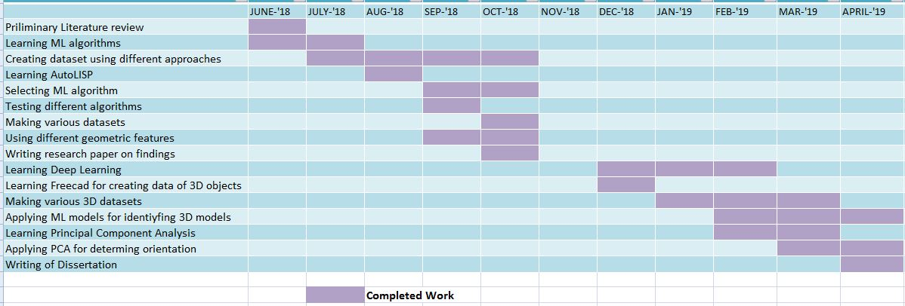
Timeframe of Work

Slide 23
THANK YOU!

